Slide 1
Cloudy with a chance of Happiness
Team Members:
Anna A.
Christiane
Christine M.
Cindy P.

Slide 2

World Happiness Report vs. Weather
Motivation
Summary
The World Happiness Report (WHR) is an annual survey on the state of global happiness.
The WHR rankings are based on the following six factors:
Many studies have been done to determine if weather has an affect on a person’s mood. The WHR does not take into account the climate of each country. Our goal is to determine if the WHR rankings show any correlation to climate by looking at the amount of sunshine, temperature and cloud cover in each country. By adding a third comparison, we can determine if there is any correlation to the rate of depression in each country and the WHR rankings; and then look to see if there is consistency between rate of depression and the weather data.
_________________________________________________________________________________________________
Without looking at the data, we might assume the locations with warmer temps, less rainfall and more sunshine would have lower rates of depression and higher WHR rankings. However, that is not the story the data tells.
When grouping the countries into 10 regions; the top two regions are the same on both the WHR rankings and regional rates of depression.
Additionally, when comparing the average annual temperature to the top, middle and bottom 10 countries, we found that the happier countries were on the cooler end of the average temperature scale and the least happy were on the warmer end.
We also found it interesting that the happiest countries were among the higher percentage of cloud cover and lesser amounts of sunshine; where the least happy were opposite.
It should also be noted that the WHR rankings were consistent with the rates of depression when looked at based on Latitude.
Income
healthy life expectancy
Social support
Freedom
Trust
Generosity
Do other factors contributing to one’s happiness correlate to the WHR rank?
Do the countries with the highest WHR ranking have higher than average amounts of sunshine, less cloudiness, less rainfall and/or lower rates of depression?
Notes:
Happiness Report Differences:
The World Happiness Report was created by the United Nations to determine the state of global happiness. It is gaining global recognition over the last five years as governments refer to it to when making policy. The weighted score is based on how people rate their happiness, economy (GDP/Capita), family, longevity, freedom, trust in the government, generosity, and dystopian view.
• Rank of the country based on the Happiness Score.
• Happiness Score
A metric measured by asking the sampled people the question: "How would you rate your happiness on a scale of 0 to 10 where 10 is the happiest."
• Standard Error
The standard error of the happiness score.
• Economy (GDP per Capita)
The extent to which GDP contributes to the calculation of the Happiness Score.
• Family
The extent to which Family contributes to the calculation of the Happiness Score
• Health (Life Expectancy)
The extent to which Life expectancy contributed to the calculation of the Happiness Score
• Freedom
The extent to which Freedom contributed to the calculation of the Happiness Score.
• Trust (Government Corruption)
The extent to which Perception of Corruption contributes to Happiness Score.
• Generosity
The extent to which Generosity contributed to the calculation of the Happiness Score.
• Dystopia Residual
The extent to which Dystopia Residual contributed to the calculation of the Happiness Score. (Dystopia is a benchmark imaginary country with the least happiest people)

Slide 3

Research Questions | Data Sources
Is there a correlation between rate of depression and the WHR ranking?
Is there a correlation between number of sunny days and the WHR ranking?
Does having more or less cloud cover on average correlate with the WHR ranking?
Is there a correlation between total annual minutes of sunshine and rate of depression?
USA Datasets:
Global Datasets:
Happiest States in America – Wallet Hub
emotional and physical well being,
work environment, and
community & environment drawn from data reported in studies since 2010.
Country and State Coordinates – Developers.Google
Current Results Weather and Science Report – Cloudiness = % of Cloudy Days, % of Sunlight because our data was missing data for three states for total sunlight hours, Temp (F)
The World Happiness Report – United Nations
Country and State Coordinates – Developers.Google
Depression Rate by Country – WHO (*2016 drove the year for the analysis)
API from worldweatheronline.com – Cloudiness = Cloud Coverage, Sunlight Min, Temp (F)
Notes:
As a group we were interested in determining whether weather affects a person’s happiness. We utilized the World Happiness Report published by the United Nations, the worldweather API to determine global weather (sunlight hours, temperature, and % of cloud coverage), and then the World Health Organization on depression for the global analysis. The other piece that we needed to consider was what coordinates to use when pulling weather for countries. We chose to use a developer’s standard by utilizing the countries.csv file published on developers.google.com. The coordinates use the latitude and longitude for the middle of the country. As well, the group was challenged with how to calculate the sunlight hours from the worldweather API by subtracting the sunrise timestamp from the sunset timestamp. This calculation was done with much manipulation, by taking the time and converting each time stamp string into minutes as an integer.
We utilized a different set of data to drill down to the individual states in the United States. We used the Happiest States in America published by Wallet Hub. As well, we decided to pull the US weather data from a different source for the sake of time. The worldweather API took hours to extract data as because there was a call made for each day of the year for thirty countries. So, we utilized data published online by Current Results Weather and Science to pull annual data that had been aggregated over years for sunlight, temperature, humidity, and precipitation for the individual states. We did need to calculate the cloudiness by determining the number of days that there is cloud coverage over thirty percent via the sunlight report.

Slide 4
Data Cleanup & Exploration Process
World Happiness Report
Using datasets from the WHR and the World Health Organization’s information on depression rates we were able to compare the rate of depression by country to the relevant WHR ranking. To extract only countries with information in both reports, we combined the datasets using an inner merge on the country name. Then narrowed our focus to 2016. Happiness vs. Rate of Depression: Using groupby to organize by region, we calculated the average happiness rating and average rate of depression for side by side comparison Happiness vs. Depression by Latitude: By merging in latitude and longitude for the countries and breaking into 5 groups of happiness score values, we were able to produce charts showing the WHR rankings based on latitude (rainbow scatterplot), including a line for the equator. Applied the same process for the depression values producing the blue scale scatterplot. Combined the data into a scatterplot for happiness score vs depression, found no correlation
Weather API, World Happiness Report and Rate of Depression Data Exploration
Extracted top 10, middle 10, and bottom 10 countries as ranked on the WHR with latitude and longitude and combined with the weather data. Then using a data frame merge to isolate the happiness and depression data from original dataset (inner merge) we were able to produce scatterplots for each of the groupings based on WHR ranking, temperature, yearly sunlight and cloud cover for comparison against latitude and longitude. Applied the same process for the depression values. There does seem to be a correlation between temperature (which sunlight and cloud cover affect) and the happiness report. Cooler temperatures are correlated with a better ranking, for the most part (some outliers); higher temps correlate with lower ranking; and this all fits with the latitude comparison to happiness rank.
Notes:
Data Cleanup & Exploration
Describe the exploration and cleanup process
Discuss insights you had while exploring the data that you didn't anticipate
Discuss any problems that arose after exploring the data, and how you resolved them
Present and discuss interesting figures developed during exploration, ideally with the help of Jupyter Notebook

Slide 5
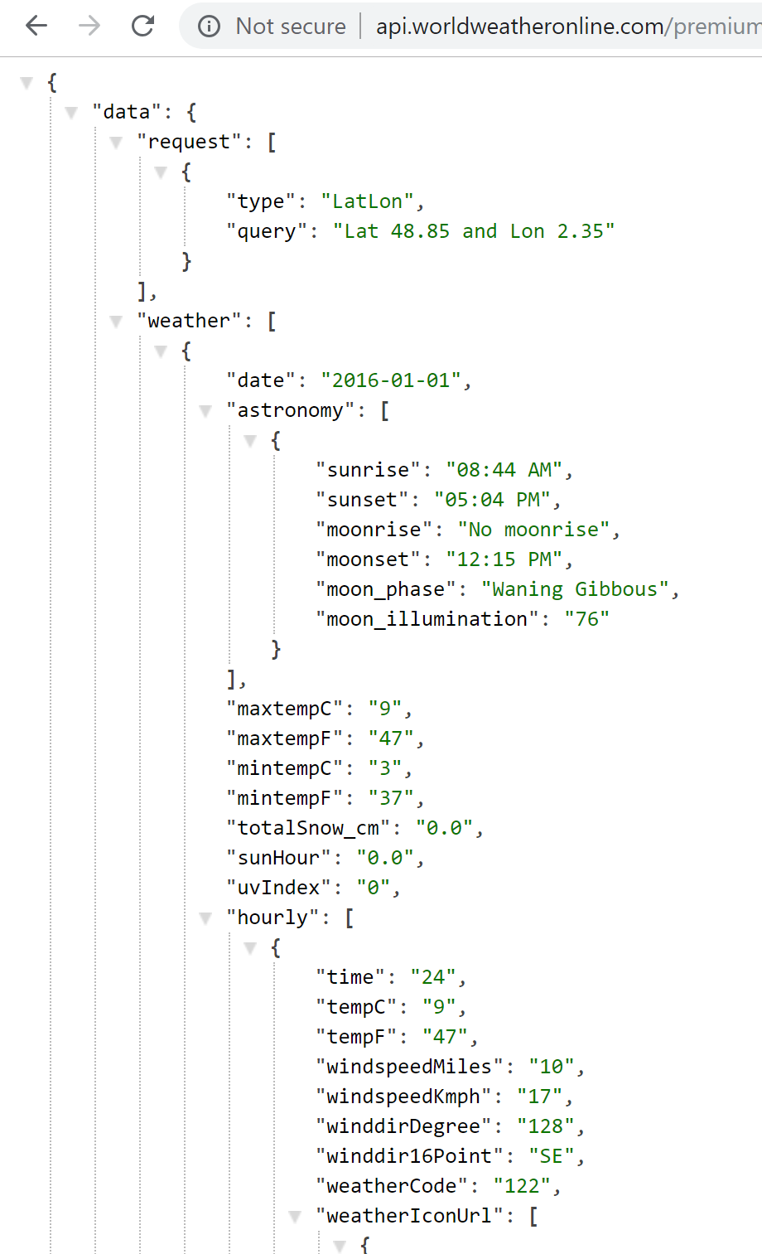
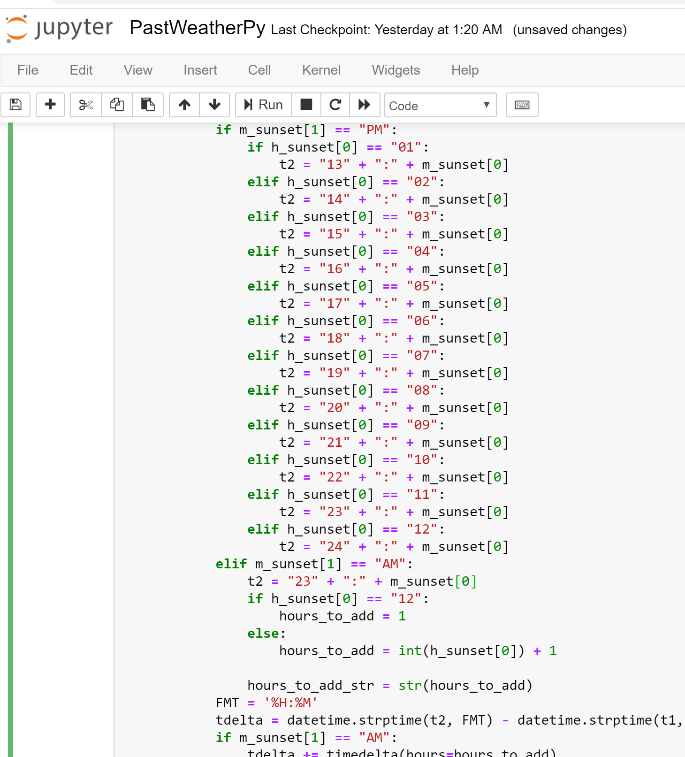
Weather API
Christiane used an API connection from worldweatheronline.com to collect historical weather data. From there we pulled data on temperature, sunrise, sunset and cloud cover passing the latitude and longitude. This API returns the data per day. The metric we decided to use in order to get the actual sunlight is to calculate the minutes between sunset and sunrise and apply the percentage of cloud cover subtracting those minutes, providing the total number of minutes annually, that each country had in 2016

Slide 6
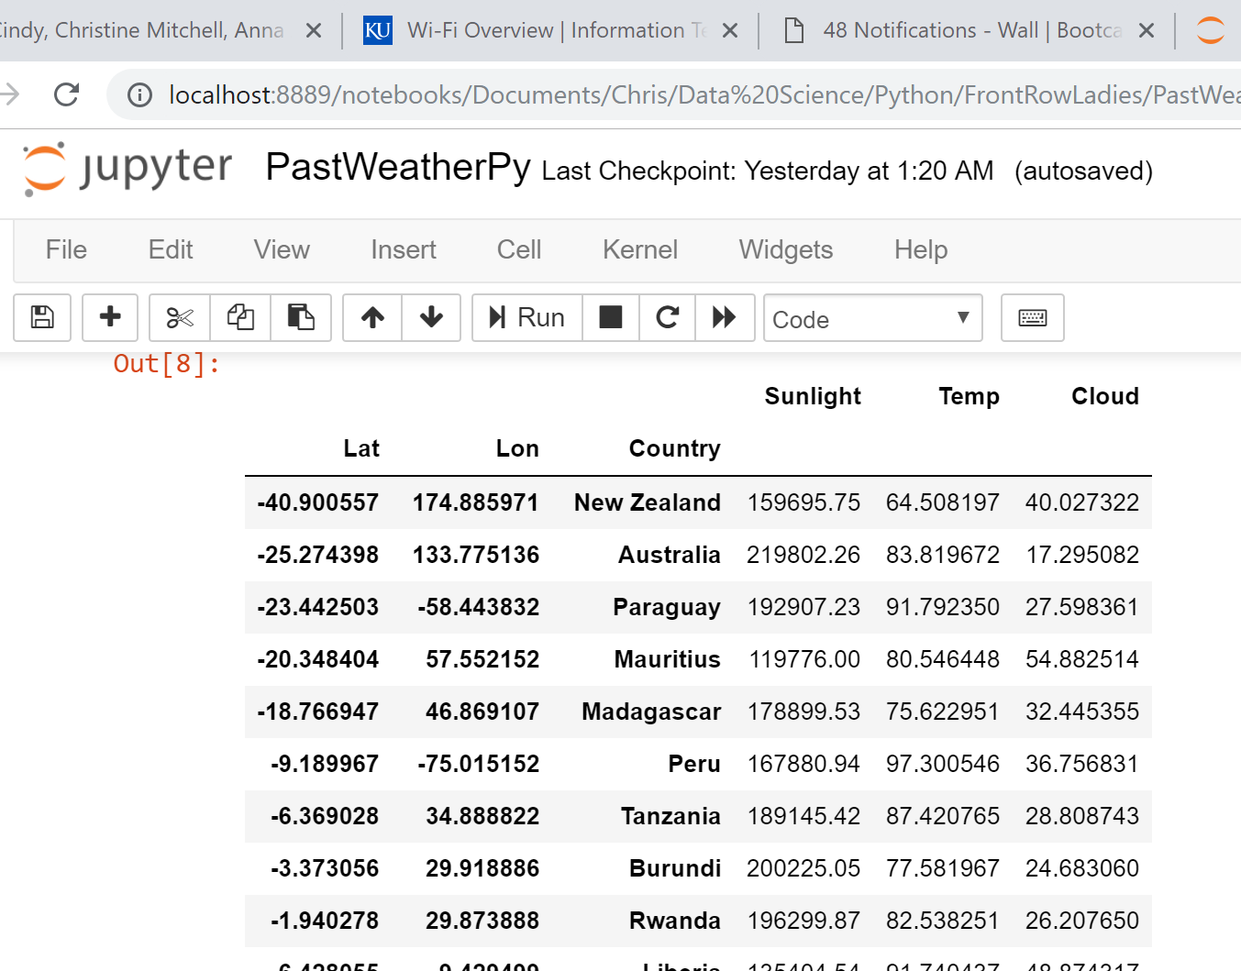
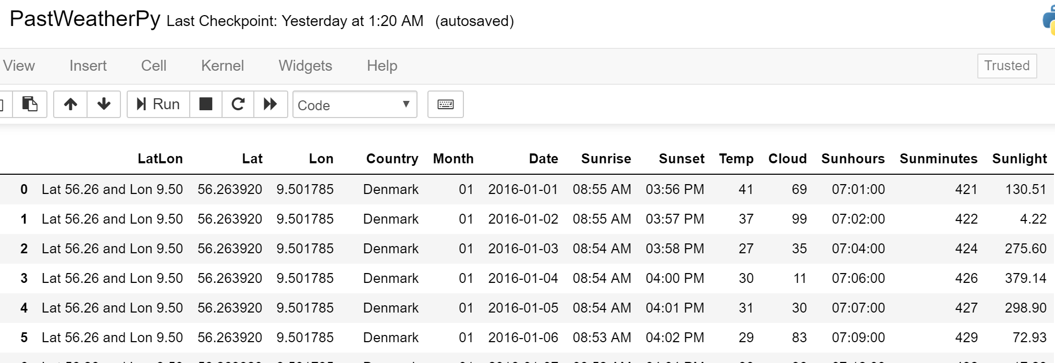
Data Cleanup & Exploration Process
cont.
Notes:
Data Cleanup & Exploration
Describe the exploration and cleanup process
Discuss insights you had while exploring the data that you didn't anticipate
Discuss any problems that arose after exploring the data, and how you resolved them
Present and discuss interesting figures developed during exploration, ideally with the help of Jupyter Notebook

Slide 7

What we learned
Notes:
Discussion
Discuss your findings. Did you find what you expected to find? If not, why not? What inferences or general conclusions can you draw from your analysis?

Slide 8

TOP 10 COUNTRIES
1 | Denmark
2 | Switzerland
3 | Iceland
4 | Norway
5 | Finland
6 | Canada
7 | Netherlands
8 | New Zealand
9 | Australia
10 | Sweden
MIDDLE 10 COUNTRIES
64 | Peru
65 | Turkishmenistan
66 | Mauritius
67 | Libya
68 | Latvia
69 | Cyprus
70 | Paraguay
71 | Romania
72 | Estonia
73 | Jamaica
BOTTOM 10 COUNTRIES
157 | Burundi
156 | Syria
155 | Togo
154 | Afghanistan
153 | Benin
152 | Rwanda
151 | Guinea
150 | Liberia
149 | Tanzania
148 | Madagascar
GLOBAL DATA

Slide 9

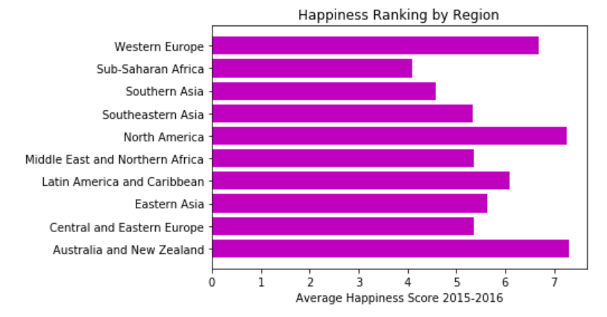
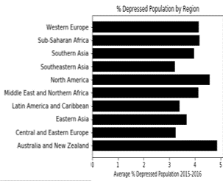
Happiness Ranking vs. Rate of Depression
Grouping by Global Region
Happiness Ranking:
Australia and New Zealand Region
North America
Rate of Depression:
Australia and New Zealand Region
North America
Conclusion: Does not support WHR results

Slide 10
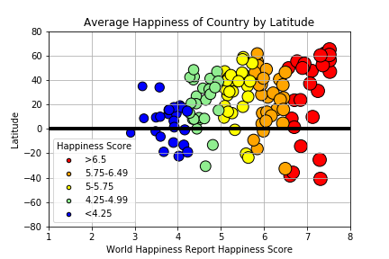
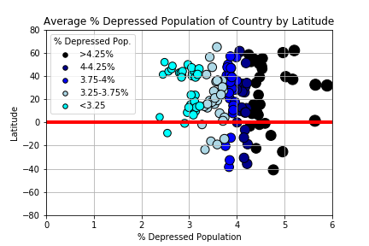
Global
Happiness vs. Depression by Latitude

Slide 11
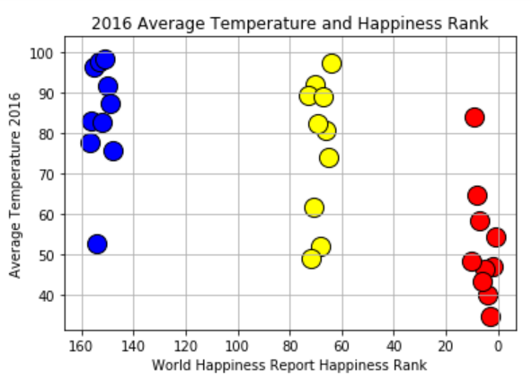
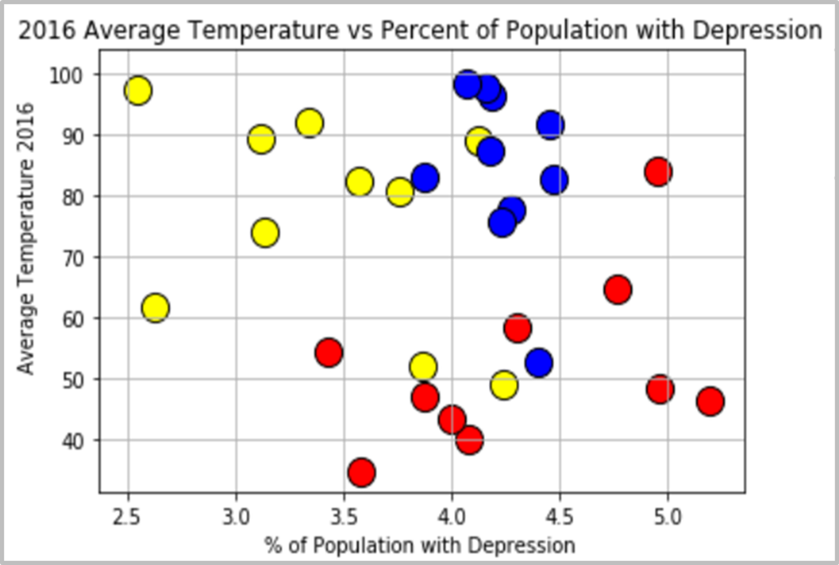
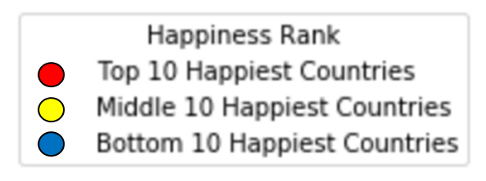
Global
Average Temperature Comparisons
Happiest countries:
Cooler average temps
Least Happiest countries: Warmer average temps
No clear difference in rates of depression

Slide 12
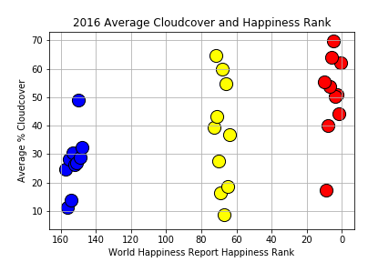
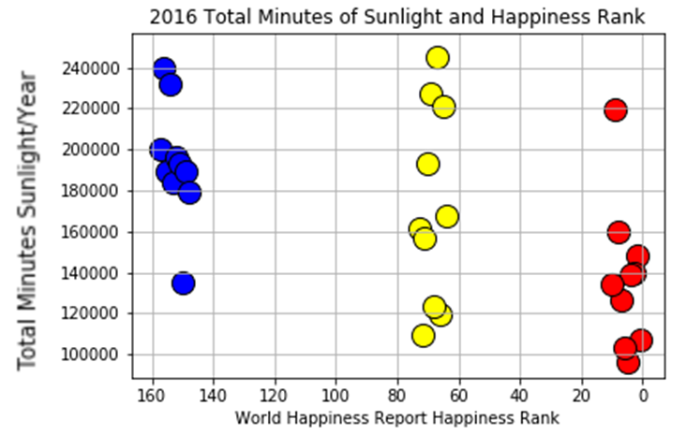
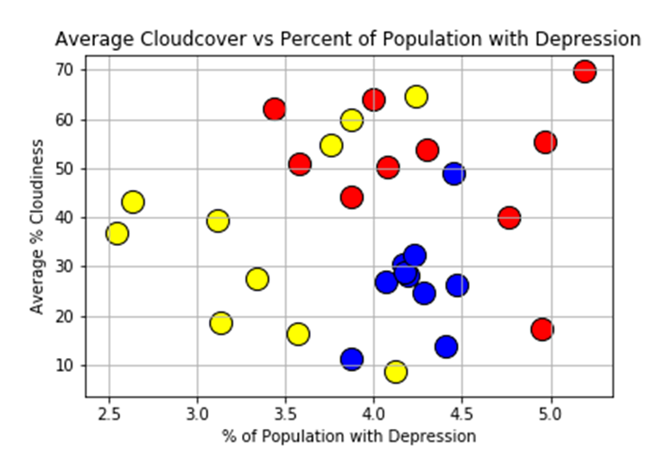
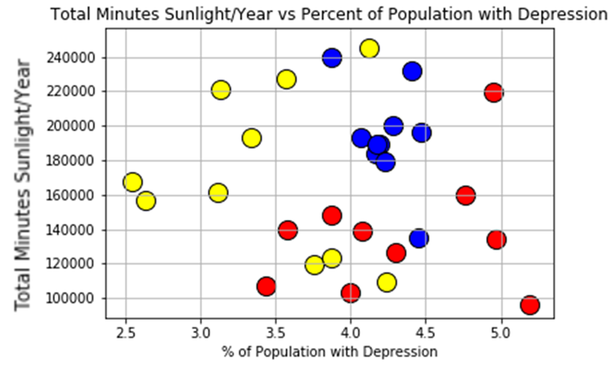
Sunlight vs. Cloudiness
Global

Slide 13
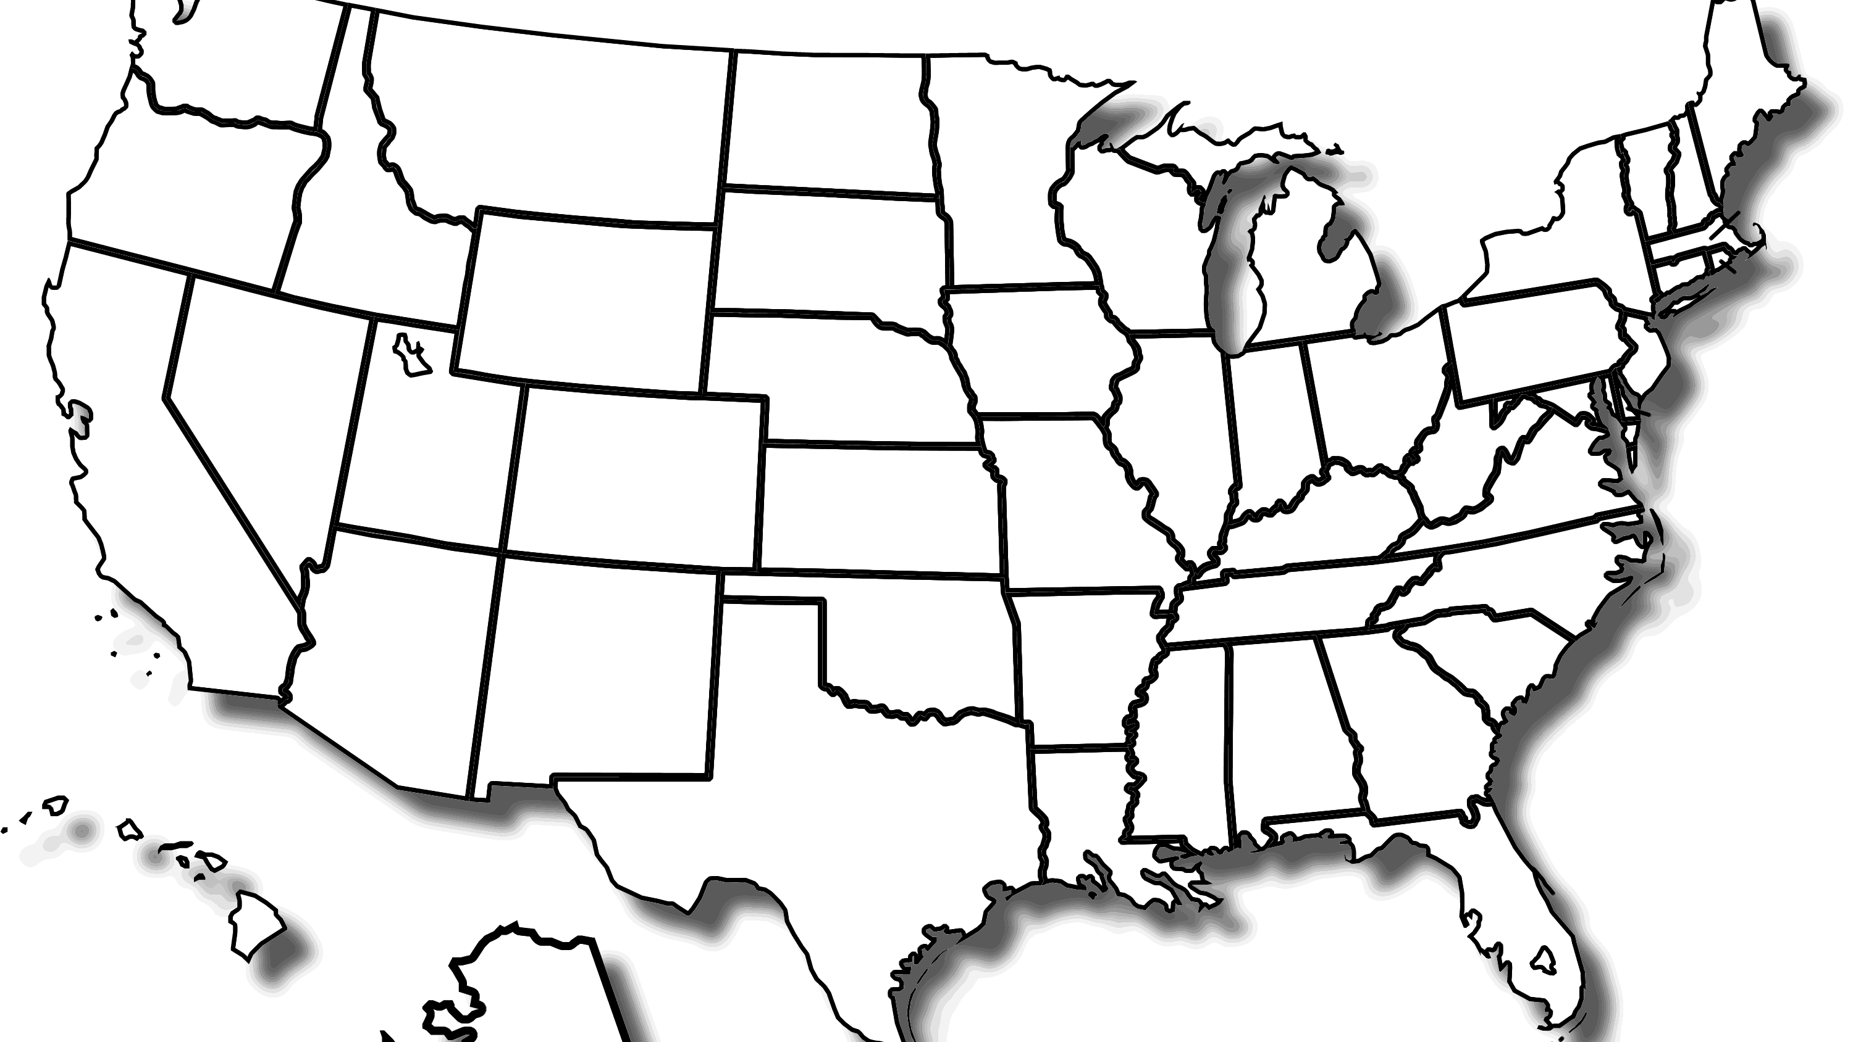

USA DATA

Slide 14
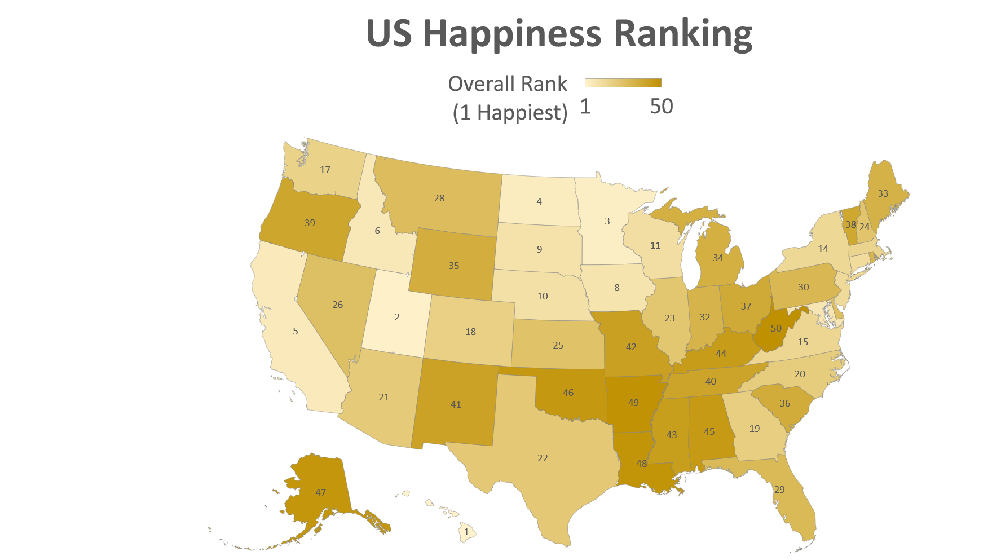


TOP 10 STATES
1 | Hawaii
2 | Utah
3 | Minnesota
4 | North Dakota
5 | California
6 | Idaho
7 | Maryland
8 | Iowa
9 | South Dakota
10 | Nebraska
MIDDLE 10 STATES
21 | Arizona
22 | Texas
23 | Illinois
24 | New Hampshire
25 | Kansas
26 | Nevada
27 | Delaware
28 | Montana
29 | Florida
30 | Pennsylvania
BOTTOM 10 STATES
50 | West Virginia
49 | Arkansas
48 | Louisiana
47 | Alaska
46 | Oklahoma
45 | Alabama
44 | Kentucky
43 | Mississippi
42 | Missouri
41 | New Mexico
#1 - Hawaii
#50 – West Virginia
Notes:
Notes: We utilized a different set of data to drill down to the individual states in the United States: The Happiest States in America published by Wallet Hub. As well, we decided to pull the US weather data from a different source for the sake of time. The worldweather API took hours to extract data as because there was a call made for each day of the year for thirty countries. For the US analysis, we utilized data published online by Current Results Weather and Science to pull annual data that had been aggregated over years for sunlight, temperature, humidity, and precipitation for the individual states. We did need to calculate the cloudiness by determining the number of days that there is cloud coverage over thirty percent via the sunlight report.

Slide 15
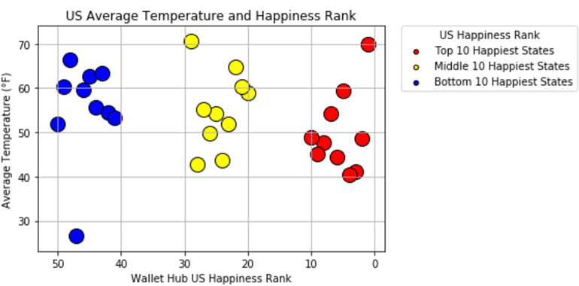
Average Temperature Comparisons
USA
There does not seem to be a distinguishable difference on WHR ranking and average temperature in the US

Slide 16
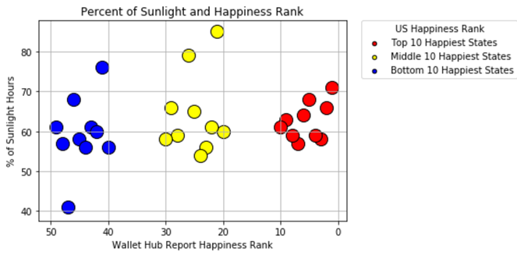
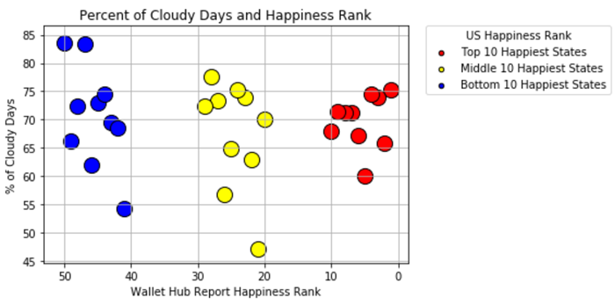
Sunlight vs. Cloudiness
USA
There does not seem to be a distinguishable difference on WHR ranking and amount of cloud cover in the US
There does not seem to be a distinguishable difference on WHR ranking and amount of Sunshine in the US

Slide 17

POST MORTEM
Discuss any difficulties that arose and how you dealt with them
Discuss any additional questions that came up, but which you didn't have time to answer.
Christiane had some issues with the amount of data pulled by the API connection and with some missing data for Iceland
We wanted to include data on natural disasters and see if they showed any impact to the WHR ranking, but access to the database is limited and requires approvals which we were not able to obtain in time.
I would say that as a team we struggled with keeping the scope of our project focused. There is so much data available that it made it tough to decide what was useful.
What would you research next, if you had two more weeks?
Two other medical diagnoses to explore would be Seasonal Affective Disorder and Vitamin D Deficiency.
We also struggled with how to reverse the order presented on the x and y axis for the graphs in order to get consistent presentation of the data once it was broken into groups.

Slide 18

FINAL THOUGHTS
There does not appear to be a correlation with weather and depression rates, or depression and the happiness report. This may be due to the fact that depression is a medical diagnosis and the WHR is based on quality of life. A person could have a very good quality of life (needs met, good family life, a good career, etc.) and still be diagnosed with clinical depression.
Depression is not the same as being unhappy.
Depression is not the opposite of happiness.
Depression is a medical condition.
Happiness is an emotional state.

Slide 19
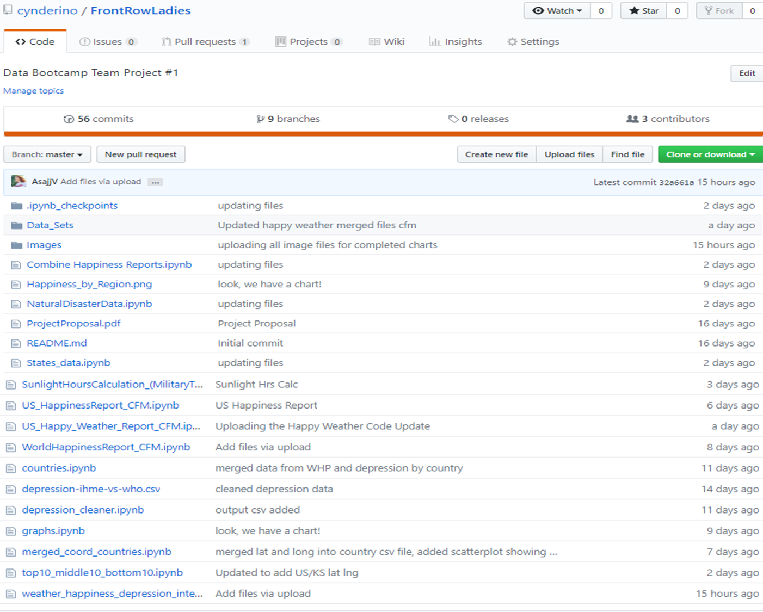
JUPYTER NOTEBOOK:
Front Row Ladies

